Slide 1
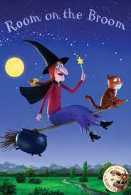
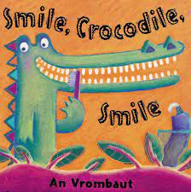
‘Celebrations’
Spring Term 2- Daycare (EYFS)- 20222/23
Comper Foundation Stage School- Oxford
Love Curiosity Courage Aspiration
This half term will be filled with exciting activities and experiences as we continue to explore seasons and dive in to a term of ‘celebrations’. Our topic will focus on a selection of key texts that will be used to support the children's learning as shown below. As well as covering the key areas of learning through immersing children through these well known and loved stories.
Our values this term is Courage.
KEY TEXTS AND RHYMES
As you know we use Tapestry, to communicate as well as celebrate your child's learning. It is lovely to see so many of you logging in and actively engaging. Remember we love to see what children get u to at home. If you have not yet manged to log on, please see a member of staff and we can support you with this.
We will also we sharing your individual Learning with you this term.
This term we will be discussing and celebrating: Bonfire night, Christmas
Discussing the importance of selfcare and teeth brushing
This term we will be focusing on the songs:
3 little men in a flying saucer and Twinkle, twinkle… Do you know how loved you are
Practicing our listening skills and investigating sounds
Making pumpkin soup and gingerbread men
Visiting our local Library
Practising new songs

Slide 2
A key aspect of our role is to provide experiences and support that will enable children to build positive relationships with children and staff, developing positive sense of themselves and of other around them.
We welcome all feelings and support ways children can manage their thoughts and feelings with the use of visual aids such a props, puppet and persona dolls and through role play .
This term we will have a focus on health and selfcare; discussing keeping healthy and the importance of teeth brushing.
Children will have the opportunity to explore a range of books supported by visuals, props and songs over a 2/3 week cycle. Promoting the use of repetition
and key phrases. These support and encourage communication and language development and confidence for storytelling. From the key texts we will focus on key word and phrases throughout the weeks.
Remember; you can borrow and return books on a weekly basis.
Physical development is vital for all- round development and both gross and fine motor skills. Outdoor learning is encouraged in all weather so please make sure your child comes suitably clothed and warmly dressed.
This term we taking part in groups games to continue to support relationship building, build confidence and courage, our value for this term.
Personal, Social and Emotional Development
Communication and Language
Physical Development
Through rhymes, singing songs, games and techniques children are supported to develop their speaking and listening skills.
A wide range of texts are readily available indoor and outdoor for children to explorer, share and retell. Our termly key texts are accessible within the environment.
We will also loan books from the library that we can share together at school.
Within Daycare we support the development of maths through construction and fun physical activities such a songs, actions and group games. Children are supported within play and in adult lead activities thorough the week.
We will having a focus on number songs and counting in sequence.
Within Understanding the World we celebrate the children of our community while also making sense of the world around us. Celebrating what makes children unique and respect individual wishes and believes.
This term we will be discussing and inclusively celebrating different special event. We will talk about Bonfire night; discussing how we keep safe.
Throughout our topic we will be supporting children to use their imagination and get creative. We will use props to support and understanding storytelling and singing. We will have weekly focused creative actives that will pride in their learning booklets, using available natural resources.
Literacy
Mathematics
Understanding of the World
Expressive Arts and Design

