Slide 1
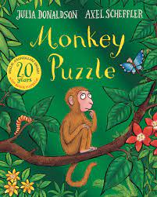
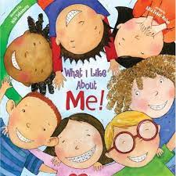
‘All Abut Me’
Spring Term 1- Daycare (EYFS)- 20222/23
Comper Foundation Stage School- Oxford
Love Curiosity Courage Aspiration
Welcome to Daycare at Comper Foundation Stage School!
This half term is filled with exciting activities and experiences as we begin the new school year together. Our topic will focus on a selection of key texts that will be used to support the children's learning as shown below. As well as covering the key areas of learning through immersing children through these well known and loved stories.
KEY TEXTS AND RHYMES
At Comper we use Tapestry, to communicate as well as celebrate your child's learning and development in their individual. It is an secure online learning journal that lets you actively engage in your child's education. They will also have an individual Learning booklet that will be shared with parents and careers termly.
Some of the activities we will be doing this term include:
This term we will be celebrating: New relationships and friendships
Getting involved with baking
This term we will be focusing on the songs: rely poly and our home song.
Learning new songs though repetition, props and rhyme
Discussing our families and people who are special to us
Discovering seasons trough exploration and creative activities
Exploring our new environment

Slide 2
A key aspect of our role is to provide experiences and support that will enable children to build positive relationships with children and staff, developing positive sense of themselves and of other around them.
We welcome all feelings and support ways children can manage their thoughts and feelings with the use of visual aids such a props, puppet and persona dolls and through role play . This will give children the confidence to feel safe in the environment around them and learning through the modelling of their peers.
Children will have the opportunity to explore a range of books supported by visuals, props and songs over a 2/3 week cycle. Promoting the use of repetition
and key phrases. These support and encourage communication and language development and confidence for storytelling. From the key texts we will focus on key word and phrases throughout the weeks. Child are also encouraged to borrow and return books on a weekly basis.
Physical development is vital for all- round development and both gross and fine motor skills. Outdoor learning is encouraged in all weather so please make sure your child comes suitably clothed and warmly dressed. This term we will be exploring both the indoor and outdoors environments, getting to know our surroundings and welcoming the upcoming weather changes.
Personal, Social and Emotional Development
Communication and Language
Physical Development
Through rhymes, singing songs, games and techniques children are supported to develop their speaking and listening skills.
A wide range of texts are readily available indoor and outdoor for children to explorer, share and retell. Our termly key texts are accessible within the environment.
staff use Makaton supported by gesture and verbal communication. Children are encouraged to have a go of our ‘signs of the week’.
Within Daycare we support the development of maths through construction and fun physical activities such a songs, actions and group games. Children are supported within play and in adult lead activities thorough the week.
Within Understanding the World we celebrate the children of our community while also making sense of the world around us. Celebrating what makes children unique and respect individual wishes and believes.
We will be making our own family books that will encourage discussion around families and people who are special to us.
Throughout our topic we will be supporting children to use their imagination and get creative. We will use props to support and understanding storytelling and singing. We will have weekly focused creative actives that will pride in their learning booklets, using available natural resources.
Literacy
Mathematics
Understanding of the World
Expressive Arts and Design

