Slide 1
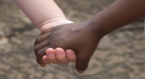

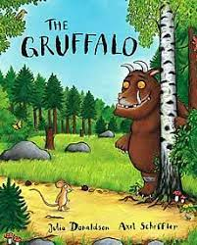
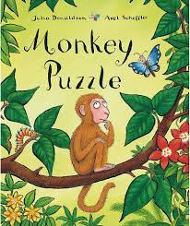
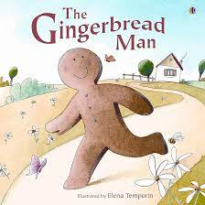
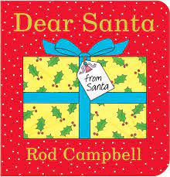
Key texts this term
Light and Dark
Caterpillars Autumn Term 2
Love Curiosity Courage Aspiration
Our key vocabulary this term is:
celebration, together, feelings, dark, light, winter, safe.
This term will be filled with exciting activities and experiences as we continue to explore seasons and dive into a term of ‘celebrations’. We use our curriculum to plan learning opportunities based on new experiences as well as those based on the children’s individual interests. Therefore our planning does adapt and develop throughout the term.
Our value this term is: Courage
This term we will be talking about and celebrating:
Bonfire night
5th November
Remembrance Sunday
9th November
Children in Need
14th November
World Nursery rhyme week
10th - 14th November
Advent
30th November - 24th December
Hanukkah
14th - 22nd December
Christmas Day
25th December
Class Dojo: Key Point!
We hope that our weekly input on Class Dojo is helpful and is providing you with a picture of our wonderful learning each week! Please do leave a like or comment as we really appreciate the feedback and parental involvement! We have an open-door policy so do catch a member of the team if you have any questions!
Key songs and rhymes:
*Twinkle twinkle little star
*Routine songs - washing hands and going home.
*Christmas songs with signs and actions.
Special events this term include:
Monday 10th - Friday 21st November - Parent consultations
Thursday 27th November 4.30pm - 6pm - Stories by Candlelight Event
Tuesday 2nd December 2-3pm- Stay & Play
Thursday 11th December - Christmas Jumper day and Christmas lunch
Wednesday 17th December 2:30-3pm - Caterpillar Christmas sing-along
Thursday 18th December Morning - Caterpillar Christmas party
Friday 19th December- Last Day of Term 1pm Close

Slide 2
I am beginning to build positive relationships with peers and staff.
I can manage/talk about feelings with support and the use of visual aids such as props, puppet and persona dolls and through role play and the support of my key person.
I know the word brave and am beginning to understand it.
I know the name of at least two feelings, happy and sad and can name them/sign them.
I can change my speed and direction in a large space without crashing into people and obstacles.
I can find and put my coat on with support.
I know the purpose of why and how we use objects e.g. kicking a ball, sipping from a cup, using a knife and fork.
I know some things I can do with my body to support balance. e.g. holding out my arms, or holding an adults hand.
I can show I have increasing attention and recall.
I can show that I have understood by my actions and words.
I know some key words and phrases/makaton signs to communicate with my peers and/or familiar adults
I know that at group time I need to listen to the adults and my peers.
Personal, Social and Emotional Development
Physical Development
Communication and Language
Autumn Term 2
Light and Dark
With support from an adult, I can take part in performing a song or rhyme as part of a group.
I can create a painting/picture that represents ‘my world’/something I am interested in
I know some lyrics and/or actions to songs and rhymes
I know that I can share my ideas and thinking
Expressive Arts and Design
I can identify different animal sounds and animal babies
I can listen to and look at my environment and make observations about what I hear and see eg animals/trees/leaves
I know some celebrations that are special to me and can discuss/show ways that I celebrate (birthday)
I know that when there are special events in people’s lives they have celebrations.
I can explore shapes, look and observe objects and begin to describe them .
I can recite numbers to at least 3.
I know how to join in with some number rhymes.
I know how to use a range of shapes to build models.
I can explore size, length, counting and shape through a range of activities.
I can explore sounds using percussion instruments and my body.
I can explore patterns and early mark making e.g. linked to our topic Bonfire Night Fireworks and other Celebrations.
I know books are something I can enjoy independently or with others.
I know some repeated phrases and refrains from familiar stories
Understanding the World
Mathematics
Literacy

