Slide 1
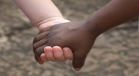
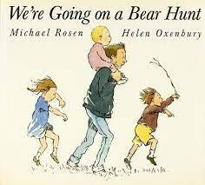
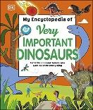
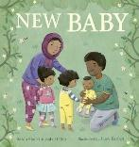
‘Discovery’
Spring Term 1- Daycare (EYFS)- 2023
Comper Foundation Stage School
Our key words this term are:
Grow
Kind
Attempt
Repeat
Measure
Experiment
Create
This half term our topic is all about finding out and discovering. It will be filled with exciting activities, experiences and opportunities linking to our core and focused key texts and by following your childs interests.
Our value this term is: Aspiration
Our BIG question this term is: Why?
As you are aware we use Tapestry, to communicate as well as celebrating your child's learning and development. Why not share what you have been up to at home? If you are new to Comper, please can you add a family photo for us to share
Some of the activities we will be doing this term include:
This term we will be celebrating: new children and families joining us, Chinese New Year and Mental Health Awareness Week.
Moving in different ways responding to spatial and positional language
Discussing our families and people who are special to us
Investigating types of dinosaurs and learning facts
Exploring health and wellbeing - visiitng our local yoga studio
Celebrating Chinese New Year!

Slide 2
A key aspect of our role is to provide experiences and support that will enable children to develop a positive sense of themselves and of others.
We welcome all feelings and support ways children can manage their thoughts and feelings with the use of visual aids such a props, puppet and persona dolls and through role play . This term we will be exploring friendship and the term: kind, Talking about similarities and differences, and exploring play opportunities in small groups.
Children will have the opportunity to explore a range of books supported by visuals, props and songs over a 2 week cycle. Promoting the use of repetition
and key phrases. These support and encourage communication and language development and confidence for storytelling. This term we will be exploring the outdoor environment going for a listening walk, learning some dinosaur names by syllables and learning new makaton signs.
Physical development is vital for all- round development and both gross and fine motor skills. Outdoor learning is encouraged in all weather so please make sure your child comes suitably clothed and warmly dressed with gloves and hats so they can explore comfortably. This term we will be exploring spatial and positional lanuague and moving in different ways.
Personal, Social and Emotional Development
Communication and Language
Physical Development
Through rhymes, singing songs, games and techniques children are supported to develop their speaking and listening skills.
Children will be encouraged to practise developing their gross and fine motor skills which are key elements for mark making.
This terms we will be exploring dinosaurs and learning facts, helping retell stories with visuals and props and using crayons and water colours to make magic marks.
Within Daycare we support the development of maths through fun and physical activities such a songs, actions and group games. We focus on the foundations of numbers 1,2,3; representing, recognising numerals and counting.
This term we will be using object to count, compare and sort , sequencing stories with support and having a go at games.
Within Understanding the world we celebrate the children of our community while also making sense of the world around us. We celebrate what makes children unique and respect individual wishes and believes.As a settling this is reflected in put celebrations, within the environment and books. This term we will be noodle tasting and experimenting with the colour red, using science to experiment and looking at our family trees.
Throughout our topic we will be supporting children to use their imagination in play and to get creative. We will use props to support understanding storytelling and singing.. This term we will be making fossils, dinosaur skelton pictures and making bear paper plates.
Literacy
Mathematics
Understanding of the World
Expressive Arts and Design

